Slide 1
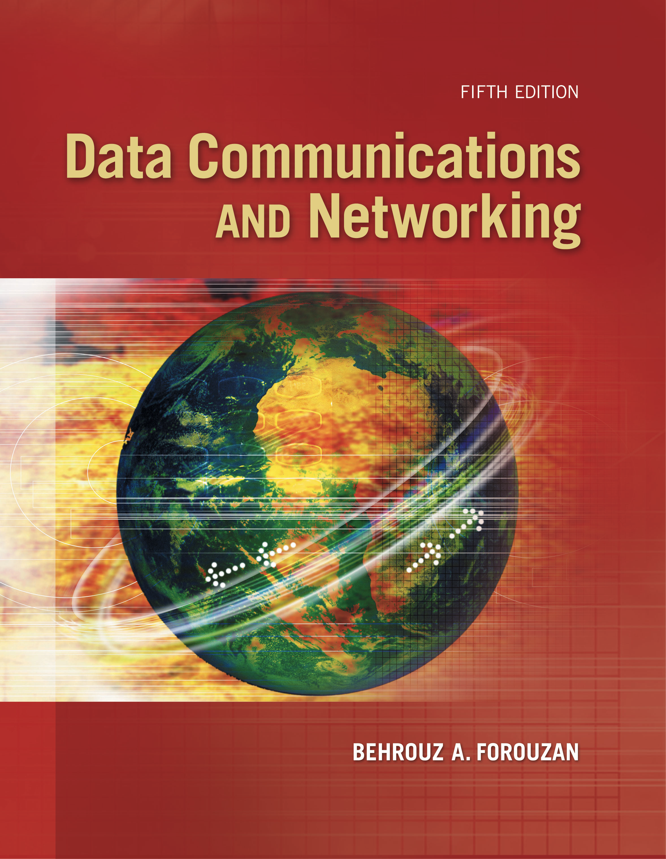
Computer Networks
Multicast Routing Protocols, IPV6
S.V.Jansi Rani
Associate Professor / CSE

Slide 2
AGENDA
Multicasting
IPV6

Slide 3



Slide 4
INTRODUCTION
Communication in the Internet today is not only unicasting;
Multicasting communication is growing fast.

Slide 5
Unicasting
In unicasting, there is one source and one destination network.
The relationship between the source and the destination network is one to one.
Each router in the path of the datagram tries to forward the packet to one and only one of its interfaces.

Slide 6
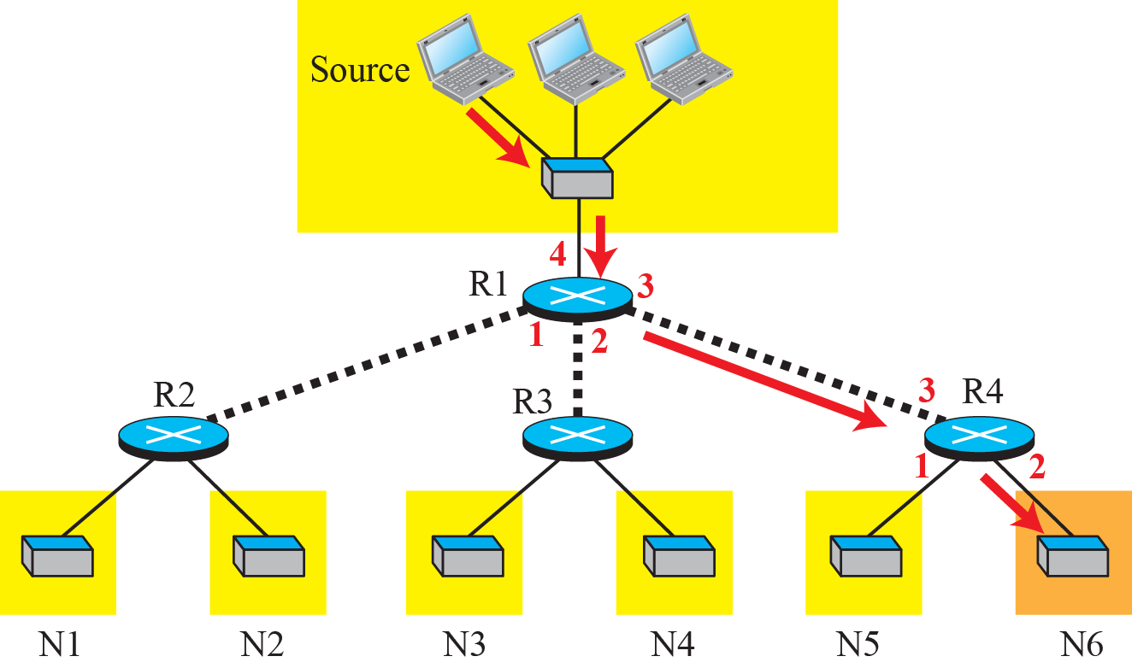
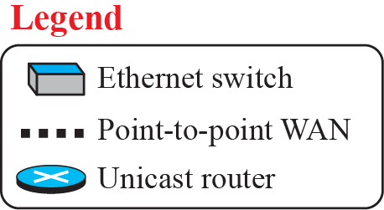

Unicasting

Slide 7
Multicasting
In multicasting, there is one source and a group of destinations.
The relationship is one to many.
Source address is a unicast address, but the destination address is a group address,
The group address defines the members of the group.

Slide 8
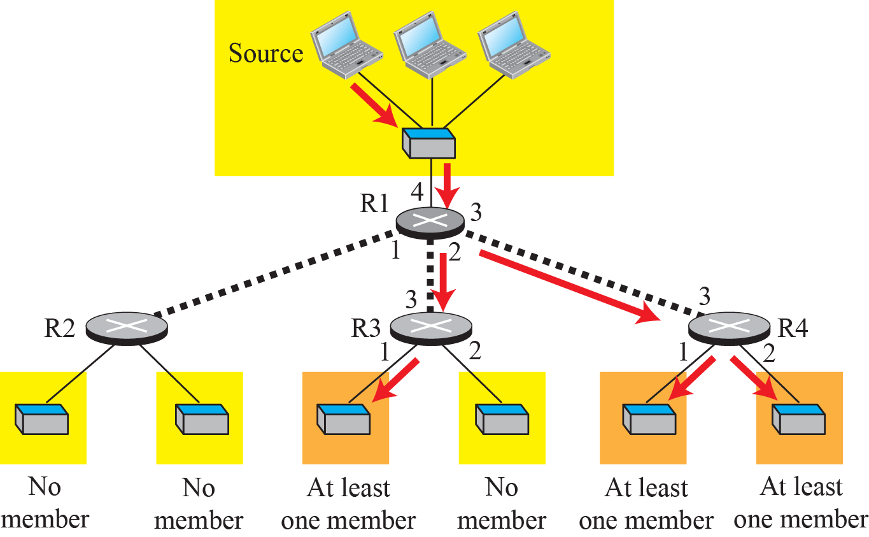
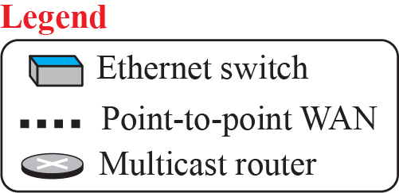
Multicasting

Slide 9
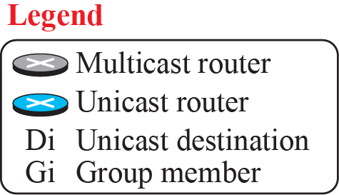
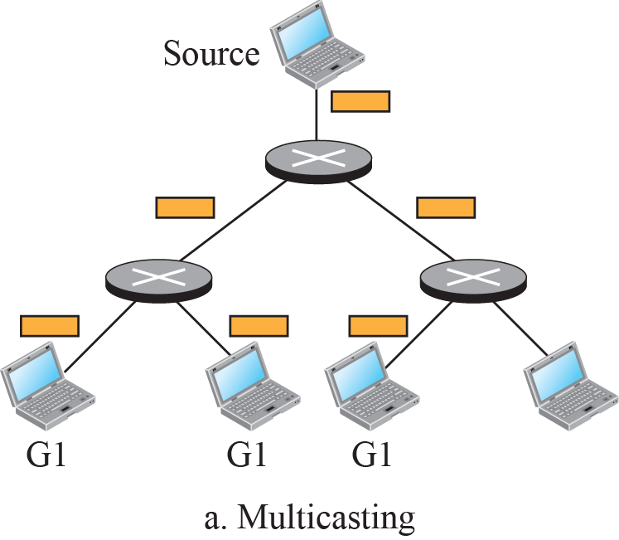
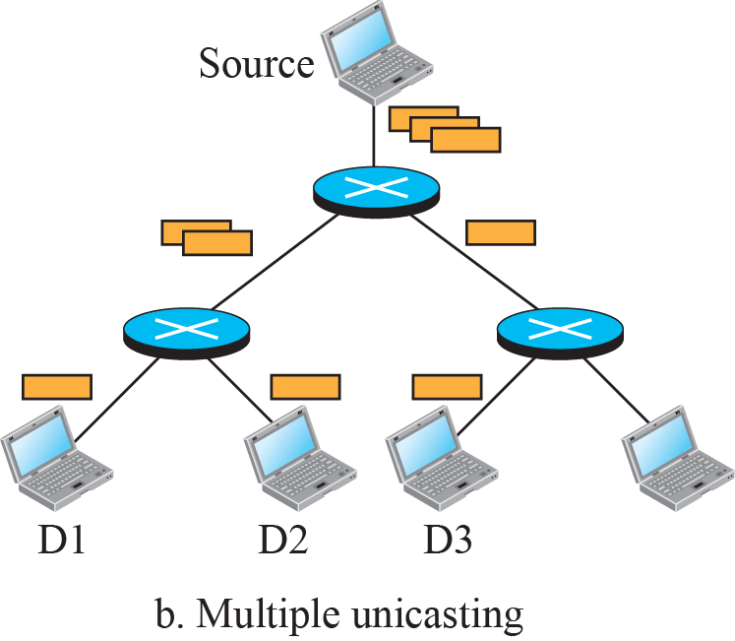
Multicasting versus multiple unicasting

Slide 10
MULTICAST Applications
Multicasting basics:
Access to distributed databases
Teleconferencing
Information dissemination
Distance learning

Slide 11
MULTICAST BASICS
Multicasting basics:
Multicast addressing
Collecting information about multicast groups
Multicast optimal trees

Slide 12
Multicast Addresses
In multicast communication, the sender is only one, but the receiver is many
We cannot include the addresses of all recipients in the packet.
We need multicast addresses
A multicast address defines a group of recipients, not a single one.
In other words, a multicast address is an identifier for a group.

Slide 13
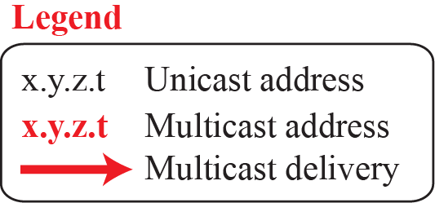
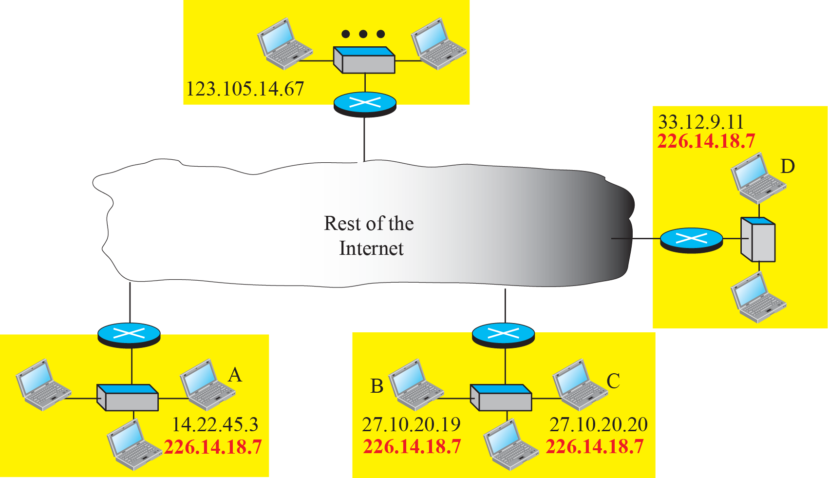
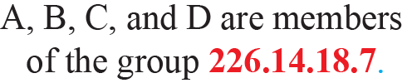
Needs for multicast addresses

Slide 14
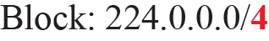
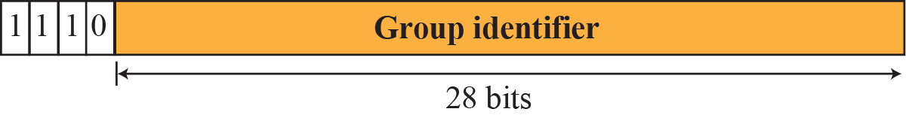
A multicast address in binary
Classful – Class D
Classless addressing used the same block, but it was
referred to as the block 224.0.0.0/4 (from 224.0.0.0 to 239.255.255.255).

Slide 15
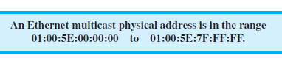
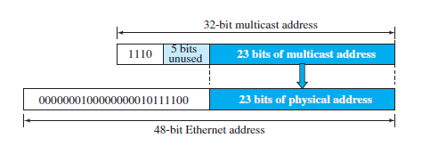
Delivery at data link layer

Slide 16
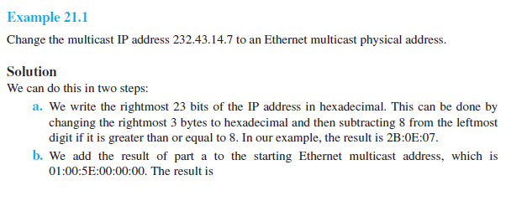
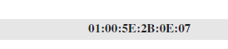

Slide 17
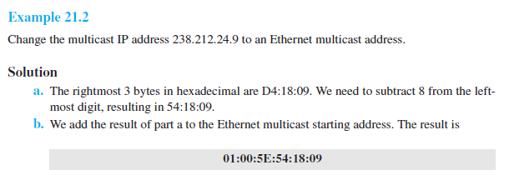

Slide 18
Collecting Information
Creation of forwarding tables in both unicast and multicast routing involves two steps:
A router needs to know to which destinations it is
connected.
2. Each router needs to propagate information obtained in the first step to all other routers so that each router knows to which destination each other router is connected.

Slide 19
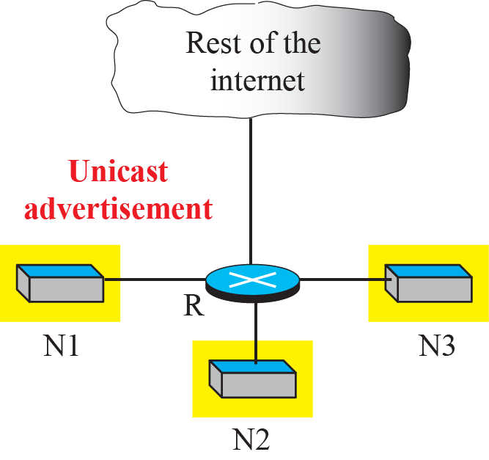
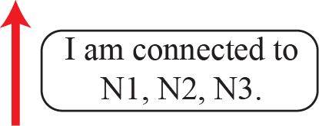
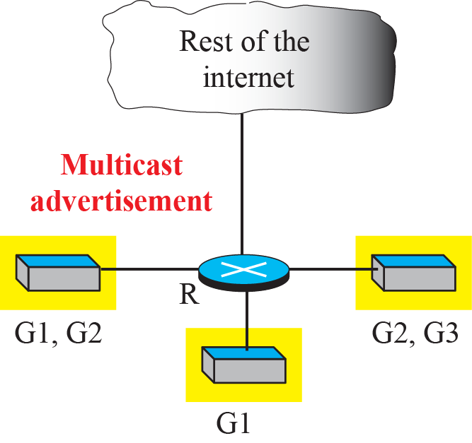
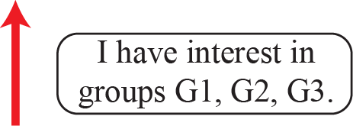
Unicast versus multicast advertisement

Slide 20
Multicast Forwarding
Another important issue in multicasting is the decision a router needs to make to forward a multicast packet. Forwarding in unicast and multicast communication is different.

Slide 21
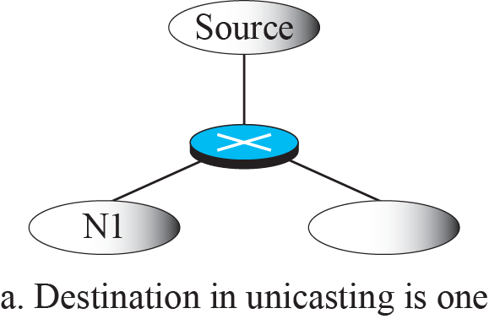


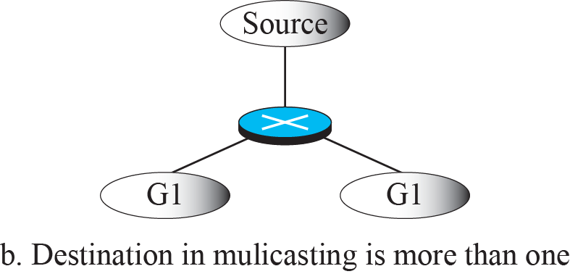

Destination in unicasting and multicasting

Slide 22
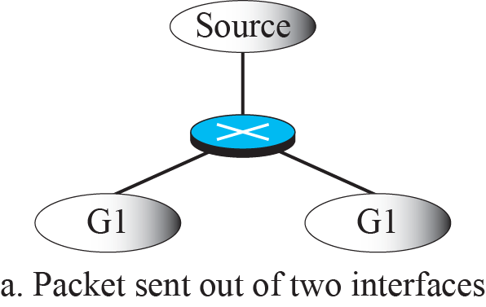



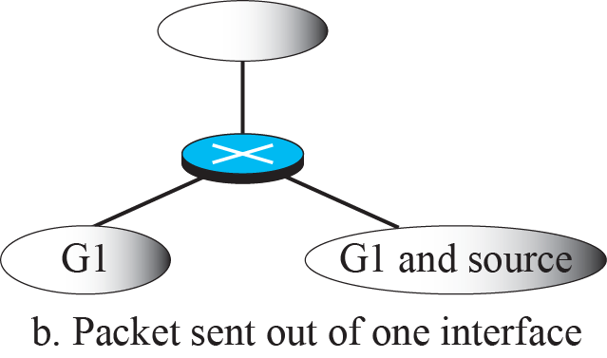

Forwarding depends on the destination and the source

Slide 23
Two Approaches to Multicasting
In multicast routing, as in unicast routing, we need to create routing trees to optimally route the packets from their source to their destination.
Multicast routing decision at each router depends not only on the destination of the packet, but also on the source of the packet.
Two different approaches in multicast routing have been developed:
Routing using source-based trees and routing using group-shared trees.

Slide 24
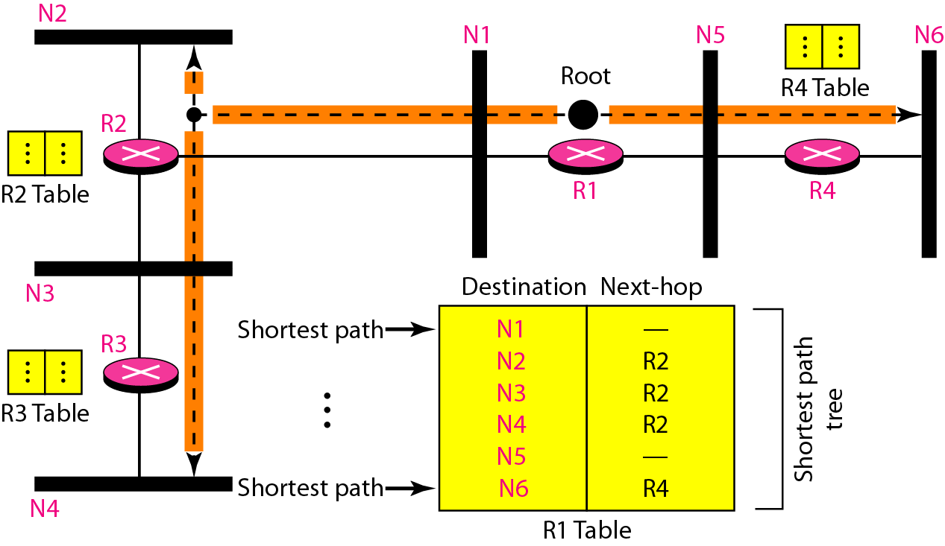
Shortest path tree in unicast routing

Slide 25
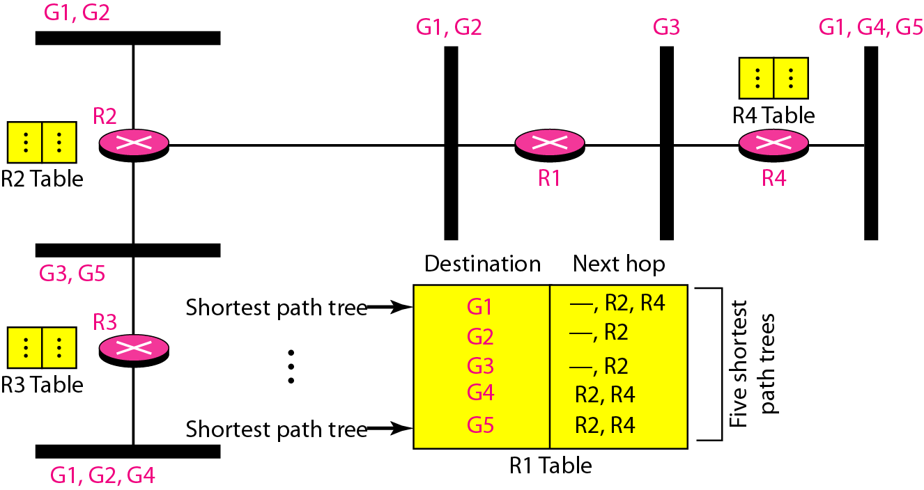
Source-based tree approach

Slide 26
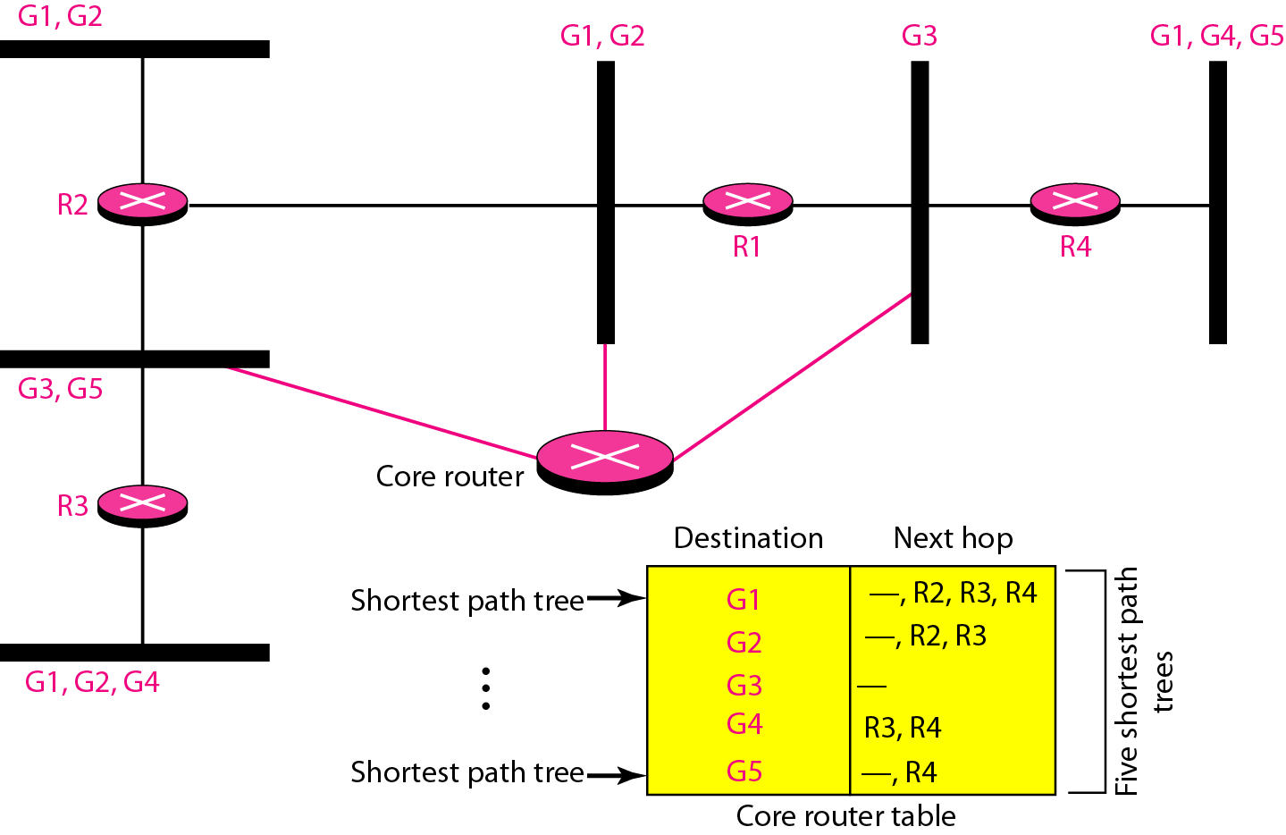
Group-shared tree approach

Slide 27
IPV6 Addressing
The main reason for migration from IPv4 to IPv6 is the small size of the address space in IPv4.
An IPv6 address is 128 bits or 16 bytes (octets) long, four times the address length in IPv4.
Representation
Abbreviation
0074 can be written as 74, 000F as F, and 0000 as 0.
Zero Compression using ::

Slide 28
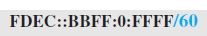
Representation
Mixed Notation
Mixed representation -colon hex and dotte ddecimal notation. -IPv4 address is embedded in an IPv6 address (as the rightmost 32 bits).
For example, the address (::130.24.24.18) is a legitimate
address in IPv6, in which the zero compression shows that all 96 leftmost bits of the address are zeros.
CIDR Notation

Slide 29
Address Space
The address space of IPv6 contains 2128 addresses. This address space is 296 times the IPv4
Size of the space is
1/64 (almost 2 percent) of the addresses in the space can be assigned to the people on planet Earth
Number of people on the earth is soon to be 2³⁴ (more than 16 billion). Each person can have 2⁸⁸ addresses to use.
Address depletion in this version is impossible.
Address Types : unicast, anycast and multicast

Slide 30
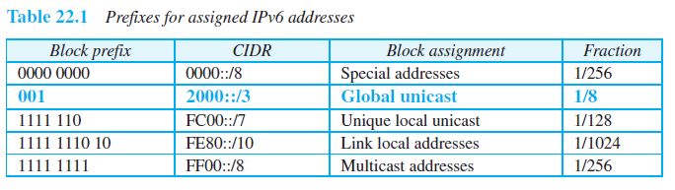
Address Space Allocation

Slide 31
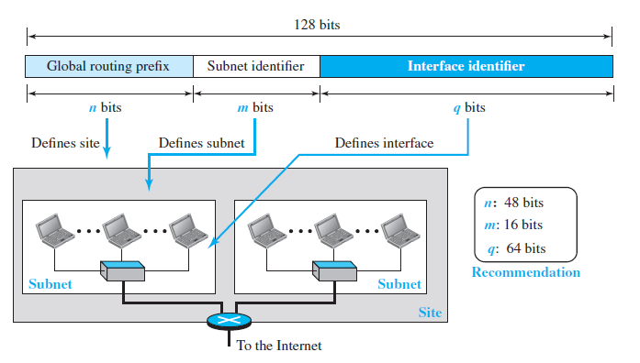
Global Unicast Address
T

Slide 32
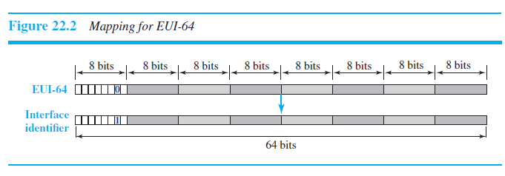
LL Addressing Schemes
Mapping Ethernet EUI-64

Slide 33
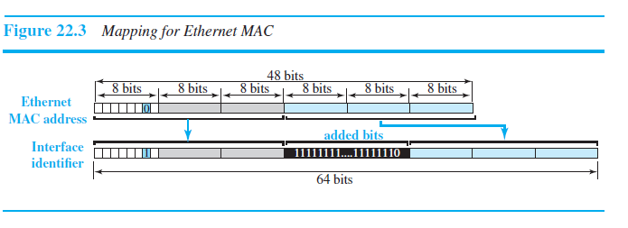
LL Addressing Schemes
Mapping Ethernet MAC Address
We need to change the local/global bit to 1 and insert an additional 16 bits.
The additional 16 bits are defined as 15 ones followed by one zero, or FFFE16.

Slide 34
Examples
An organization is assigned the block 2000:1456:2474/48. What is the CIDR notation for the blocks in the first and second subnet
Theoretically, the first and second subnets should use the blocks with subnet identifier 000116 and 000216. This means that the blocks are 2000:1456:2474:0000/64 and 2000:1456:2474:0001/64

Slide 35
Using the format we defined for Ethernet addresses, find the interface identifier if the physical address in the EUI is (F5-A9-23-EF-07-14-7A-D2)16.
We only need to change the seventh bit of the first octet from 0 to 1 and change the format to colon hex notation. The result is F7A9:23EF:0714:7AD2.

Slide 36
An organization is assigned the block 2000:1456:2474/48. What is the IPv6 address of an interface in the third subnet if the IEEE physical address of the computer is (F5-A9-23-14-7A-D2)
The interface identifier for this interface is F7A9:23FF:FE14:7AD2. If we append this identifier to the global prefix and the subnet identifier, we get:
2000:1456:2474:0003:F7A9:23FF:FE14:7AD2/128

Slide 37
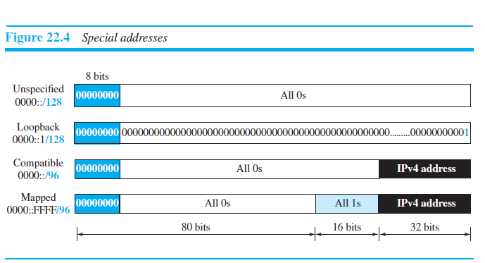
Special Addresses

Slide 38
Autoconfiguration
When a host in IPv6 joins a network, it can configure itself using the following process:
The host first creates a link local address for itself. This is done by taking the 10-bit link local prefix (1111 1110 10), adding 54 zeros, and adding the 64-bit interface
identifier, which any host knows how to generate from its interface card. The result is a 128-bit link local address.
The host then tests to see if this link local address is unique - neighbor solicitation message and waits for a neighbour advertisement message.
If passed, the host stores - link local address (for private communication), but it still needs a global unicast
address. The host - router solicitation message - local router -router advertisement message -global unicast prefix or flag.

Slide 39
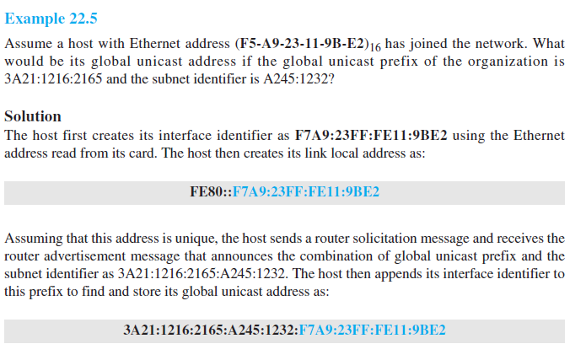

Slide 40
IPV6 Packet Format
Changes
Better header format
New options
Allowance for extension
Support for resource allocation
Support for more security

Slide 41
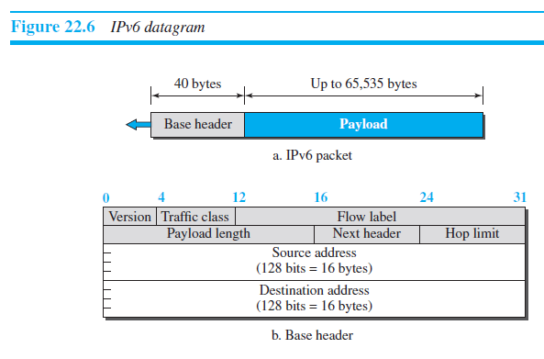

Slide 42
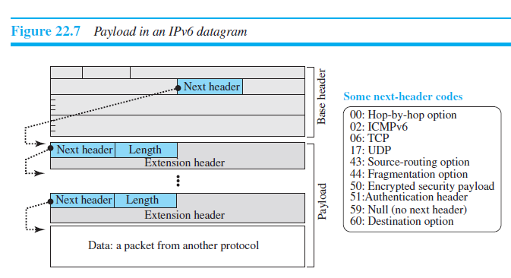

Slide 43
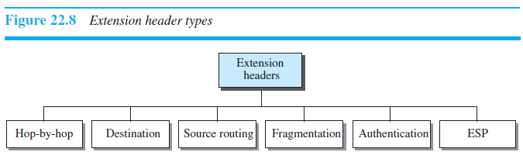

Slide 44
Check Your Understanding
Difference between IPV4 and IPV6
What is the role of router in multicasting?

Slide 45
Outcome
Student should be able to understand
Transport Layer Flow control protocols
Simple protocol
Stop and wait protocol
Go back N protocol
Selective Repeat protocol

Slide 46
THANK YOU

